Slide 1

14.3 Partial Derivatives

Slide 2
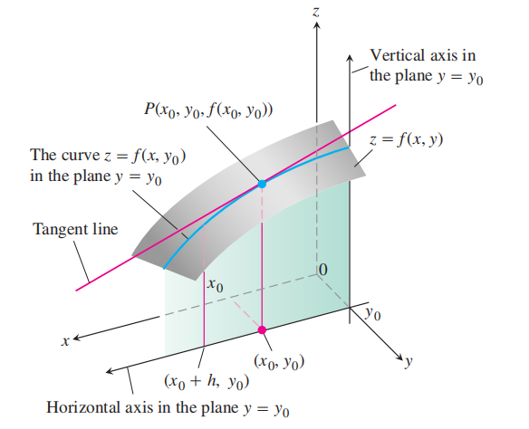

Slide 3

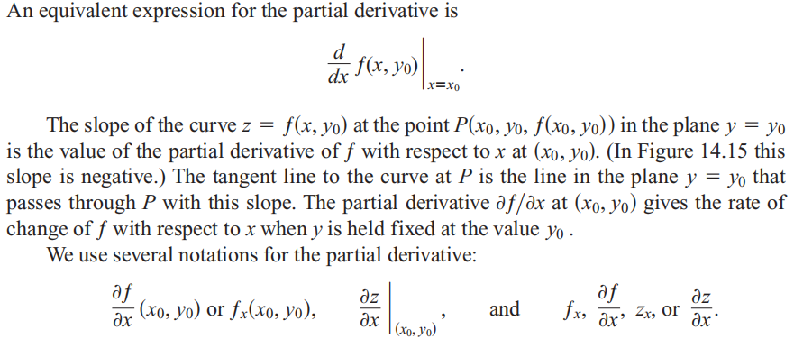

Slide 4



Slide 5
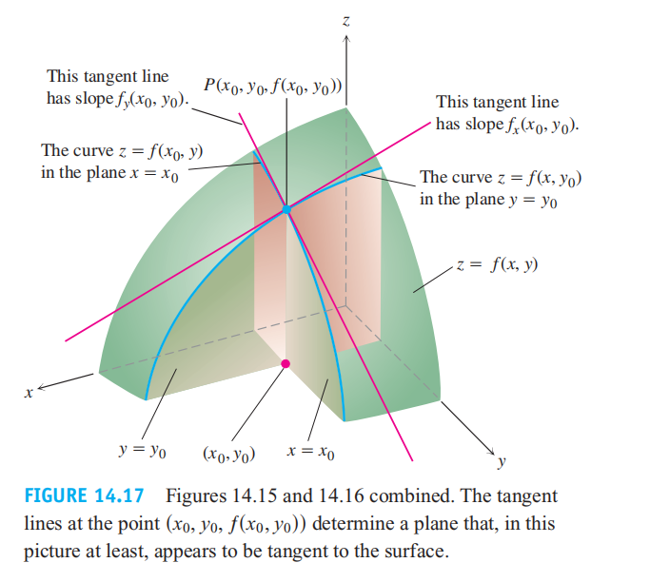

Slide 6

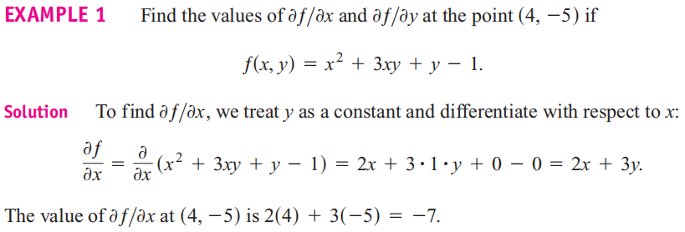


Slide 7


Slide 8
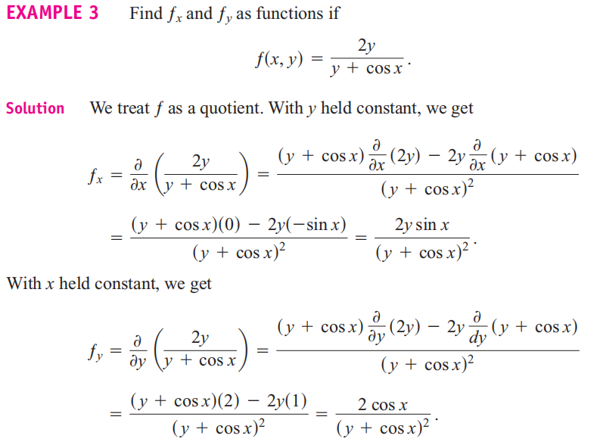

Slide 9
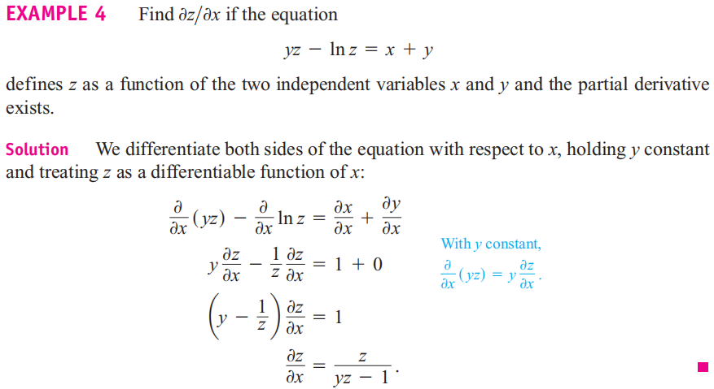

Slide 10
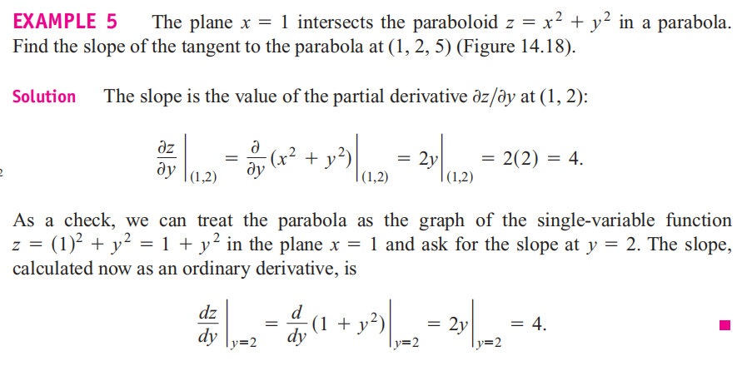
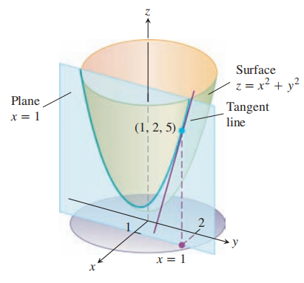

Slide 11
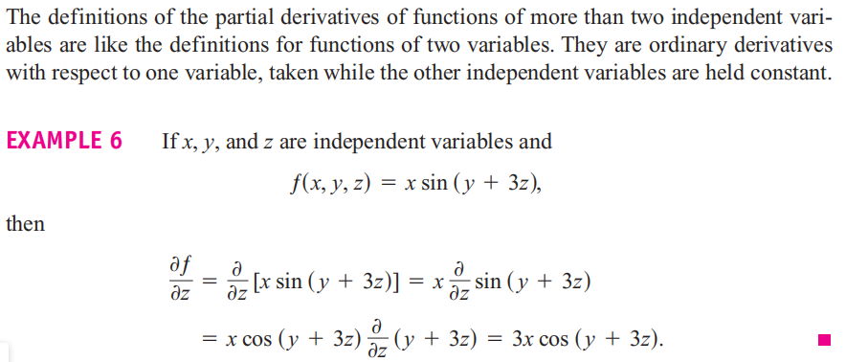

Slide 12

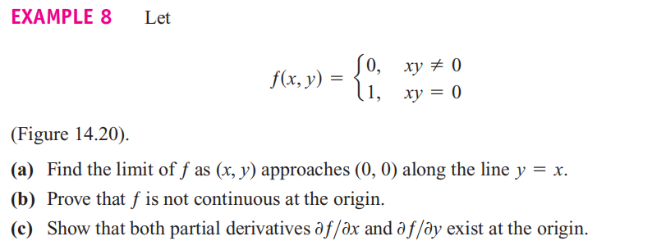

Slide 13
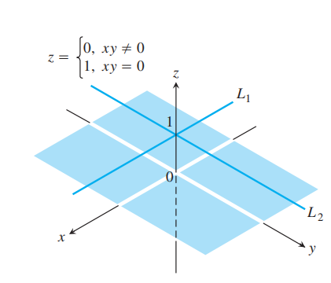
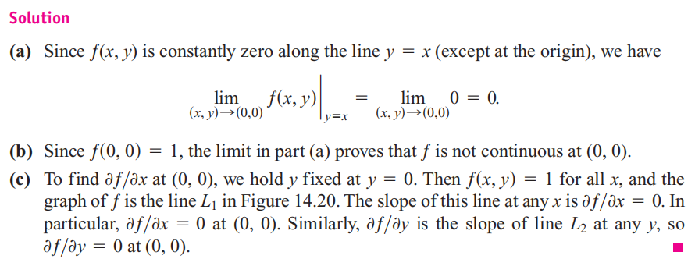

Slide 14

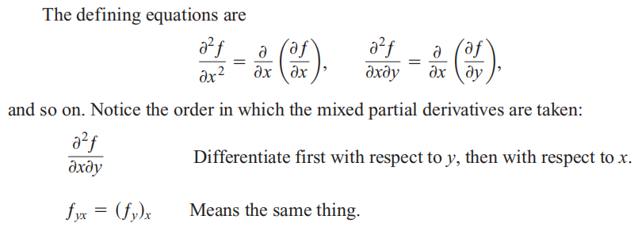

Slide 15
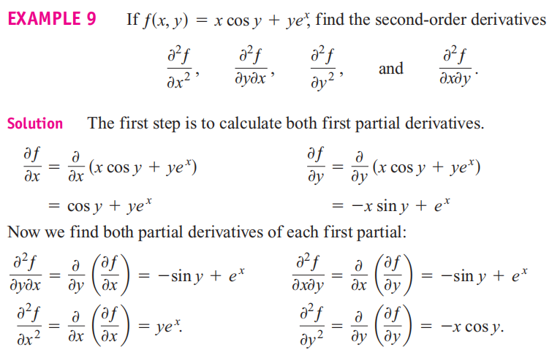

Slide 16

Theorem 2 says that to calculate a mixed second-order derivative, we may differentiate in either order, provided the continuity conditions are satisfied. This ability to proceed in different order sometimes simplifies our calculations.

Slide 17
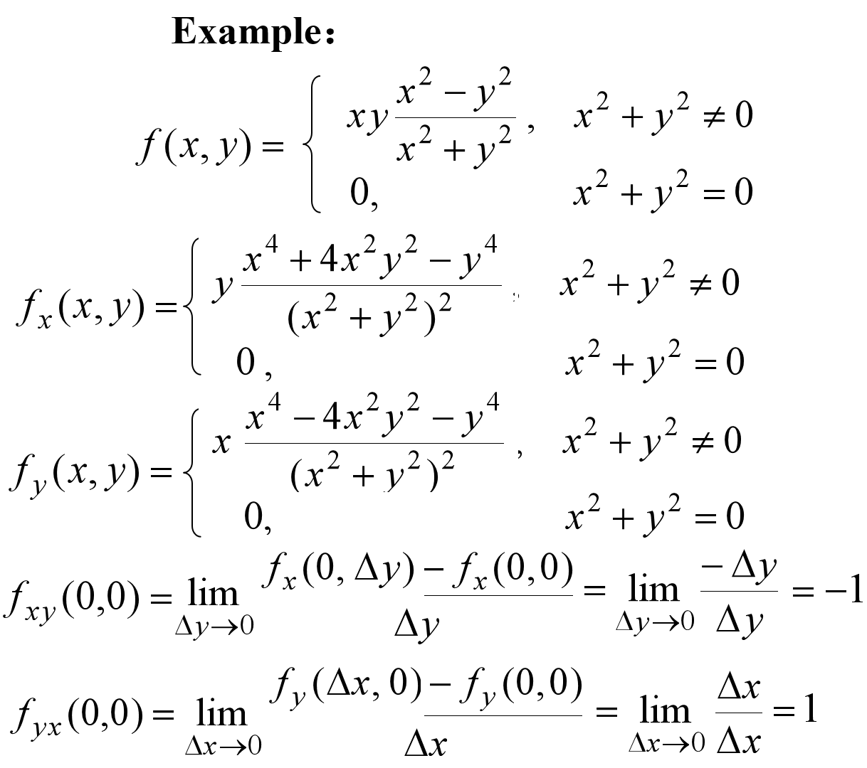

Slide 18



Slide 19
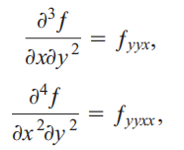

Partial Derivatives of Still Higher Order

Slide 20

Differentiability

Slide 21
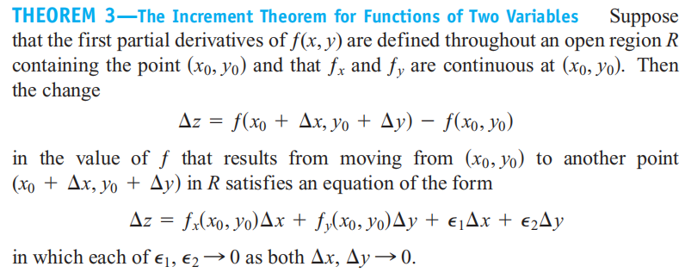


Slide 22
Continuity
Partial derivatives exist
Differentiability
Partial derivatives are continuous

Slide 23
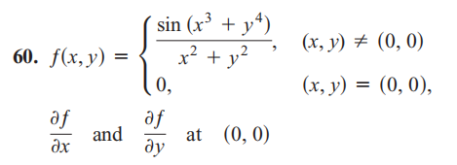

Slide 24


Slide 25

How to Linearize a Function of Two Variables
Functions of two variables can be complicated, and we sometimes need to approximate them with simpler ones that give the accuracy required for specific applications without
being so difficult to work with. We do this in a way that is similar to the way we find linear replacements for functions of a single variable (Section 3.11).

Slide 26
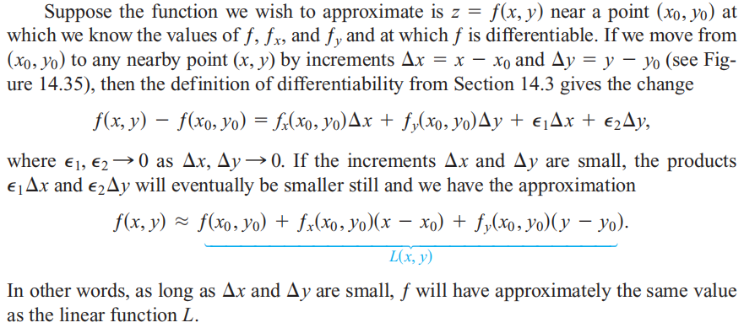


Slide 27
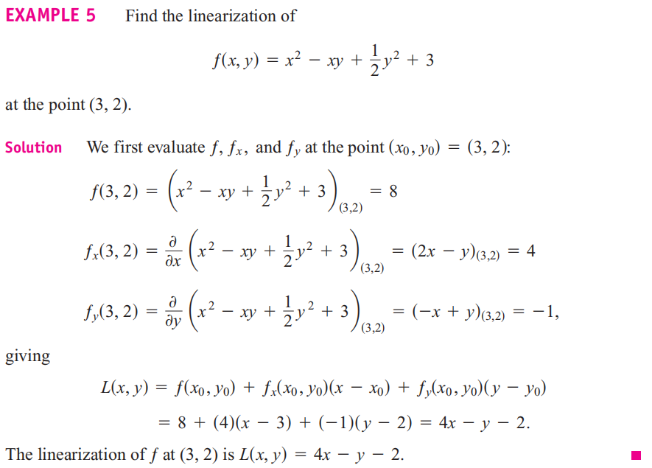

Slide 28
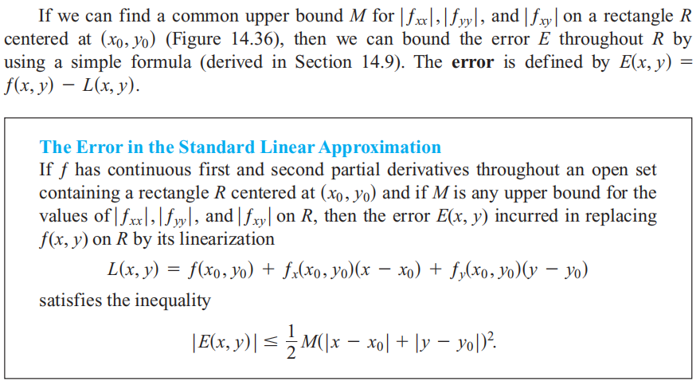

Slide 29
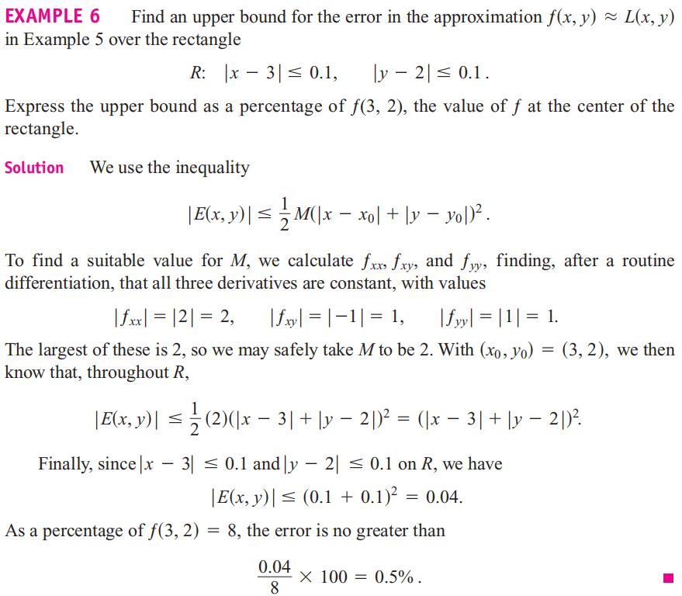

Slide 30


Slide 31
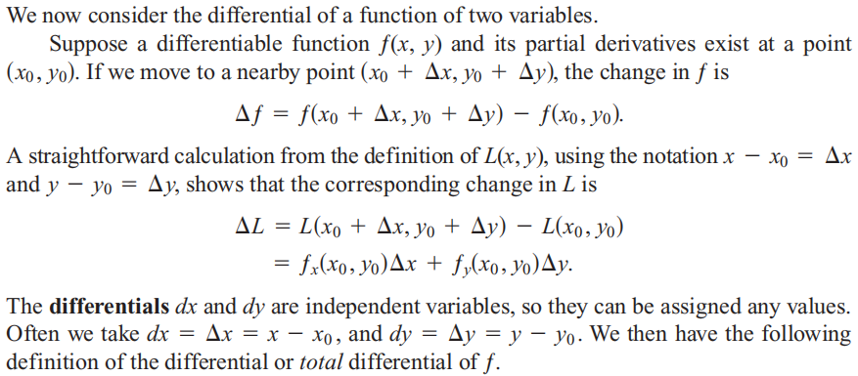


Slide 32
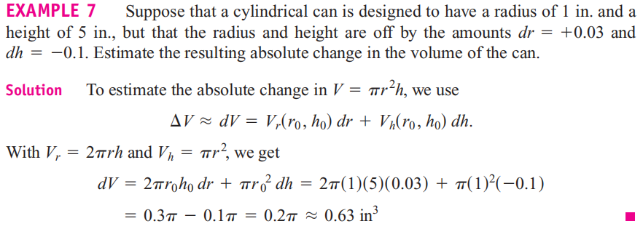

Slide 33
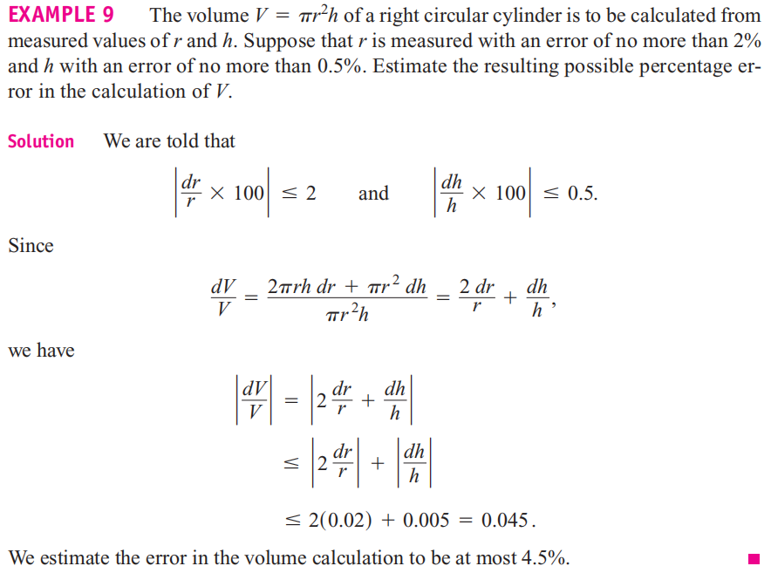

Slide 34
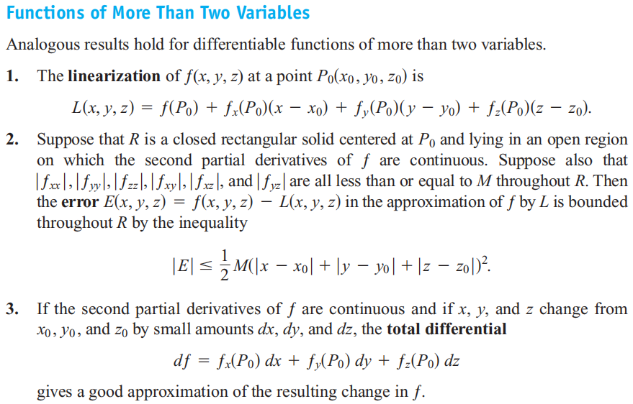

Slide 35
